Slide 1
Name : B Ramya sri Reg no: 711120106014 Branch : ECE
const int TRIG_PIN = 2;
const int ECHO_PIN = 4;
long duration, distance;
int a = 14;
int b = 12;
int c = 13;
void setup() {
Serial.begin(115200);
pinMode(TRIG_PIN, OUTPUT);
pinMode(ECHO_PIN, INPUT);
pinMode(a, INPUT);
pinMode(b, INPUT);
pinMode(c, INPUT);
pinMode(a, OUTPUT);
pinMode(b, OUTPUT);
pinMode(c, OUTPUT);
}

Slide 2
void loop() {
distance = getDistanceInCentimeters();
Serial.println("Distance = "+ String(distance));
delay(1000);
if (distance >= 100)
{
digitalWrite(a , HIGH);
}
else{
digitalWrite(a, LOW);
}
if(distance >= 200)
{
digitalWrite(a, HIGH);
digitalWrite(b, HIGH);
}
else{
digitalWrite(a, LOW);
digitalWrite(b, LOW);
}

Slide 3
if(distance >= 300)
{
digitalWrite(a, HIGH);
digitalWrite(b, HIGH);
digitalWrite(c, HIGH);
}else{
digitalWrite(a, LOW);
digitalWrite(b, LOW);
digitalWrite(c, LOW);
}
}
long getDistanceInCentimeters() {
digitalWrite(TRIG_PIN,LOW);
delayMicroseconds(2);
digitalWrite(TRIG_PIN, HIGH);
delayMicroseconds(10);
digitalWrite(TRIG_PIN, LOW);
duration = pulseIn(ECHO_PIN, HIGH);
return (duration * 0.034 / 2) + 1;
}

Slide 4
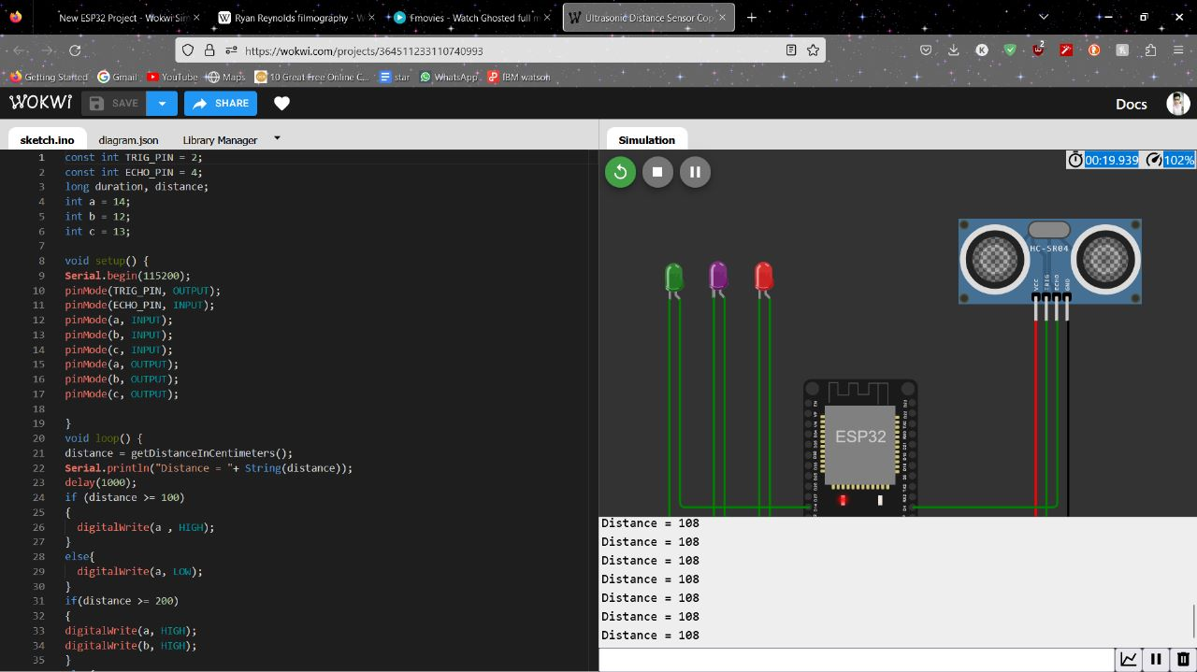
https://wokwi.com/projects/364511233110740993

